Slide 1

FRONT-END WEB DEVELOPMENT
BY IDOWU TIJESUNI

Slide 2


TOPICS WE WILL COVER
WHAT IS A WEBSITE?
WEB DEVELOPMENT
WEB DEVELOPERS
FRONT-END DEVELOPMENT
BACK-END DEVELOPMENT
HTML, CSS, JAVASCRIPT

Slide 3

WHAT IS A WEBSITE?
The definition of a website is a page or collection of pages on the World Wide Web that contains specific information which was all provided by one person or entity and traces back to a common Uniform Resource Locator (URL).
Facebook and MySpace are examples of websites.

Slide 4

WEB DEVELOPMENT
Web development can simply be defined as the building and maintenance of websites for hosting via the internet or intranet (a private network).
It’s all about creating web pages (websites) or applications (such as Amazon or Facebook) that run in a web browser. Web development often involves learning several programming languages, frameworks, databases, etc. as different websites and apps use different technologies and have different functionalities.

Slide 5
WEB DEVELOPER
A WEB DEVELOPER IS A KIND OF PROGRAMMER WHO SPECIALIZES IN THE DEVELOPMENT OF APPLICATIONS RELATING TO THE WORLD WIDE WEB

Slide 6
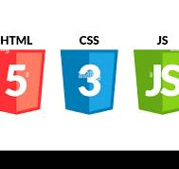
FRONT-END DEVELOPMENT
Front-end web development, also known as client-side development is the practice of producing HTML, CSS and JavaScript for a website or Web Application so that a user can see and interact with them directly.
The objective of designing a site is to ensure that when the users open up the site they see the information in a format that is easy to read and relevant

Slide 7
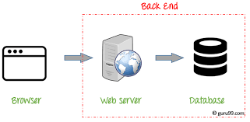
BACK END DEVELOPMENT Back end development refers to the server side of an application and everything that communicates between the database and the browser. Java, PHP, Ruby on Rails, Python and .Net.

Slide 8
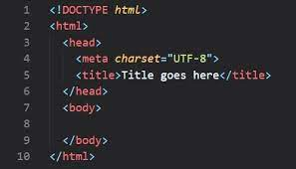
HTML (Hypertext Markup Language)
OVERVIEW
Hypertext Markup Language (HTML) is the standard markup language for creating web pages and web applications.
Web browsers receive HTML documents from a web server or from local storage and render the documents into multimedia web pages. HTML describes the structure of a web page semantically and originally included cues for the appearance of the document.

Slide 9
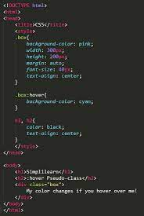
CSS (Cascading Style Sheets)
Cascading Style Sheets (CSS) is a style sheet language used for describing the presentation of a document written in a markup language like HTML.
CSS is designed to enable the separation of presentation and content, including layout, colors and fonts.

Slide 10
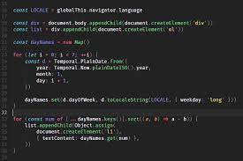
JAVASCRIPT
A high-level, interpreted programming language .. It is a dynamic language.
JavaScript enables interactive web pages and is an essential part of web applications.
The vast majority of websites use it, and major web browsers have a dedicated JavaScript engine to execute it.

Slide 11
Thank you…..

